Slide 1
Transformation in Post-Tonal Music
John Roeder

Slide 2
transformational network
“Nacht” from Schoenberg’s Pierrot Lunaire:
circles are nodes of the network,
symbols denote a particular quality of the corresponding event.
Pairs of nodes connected by directed arrows, labeled by the transformation that changes the object at the tail into the object at the head.

Slide 3
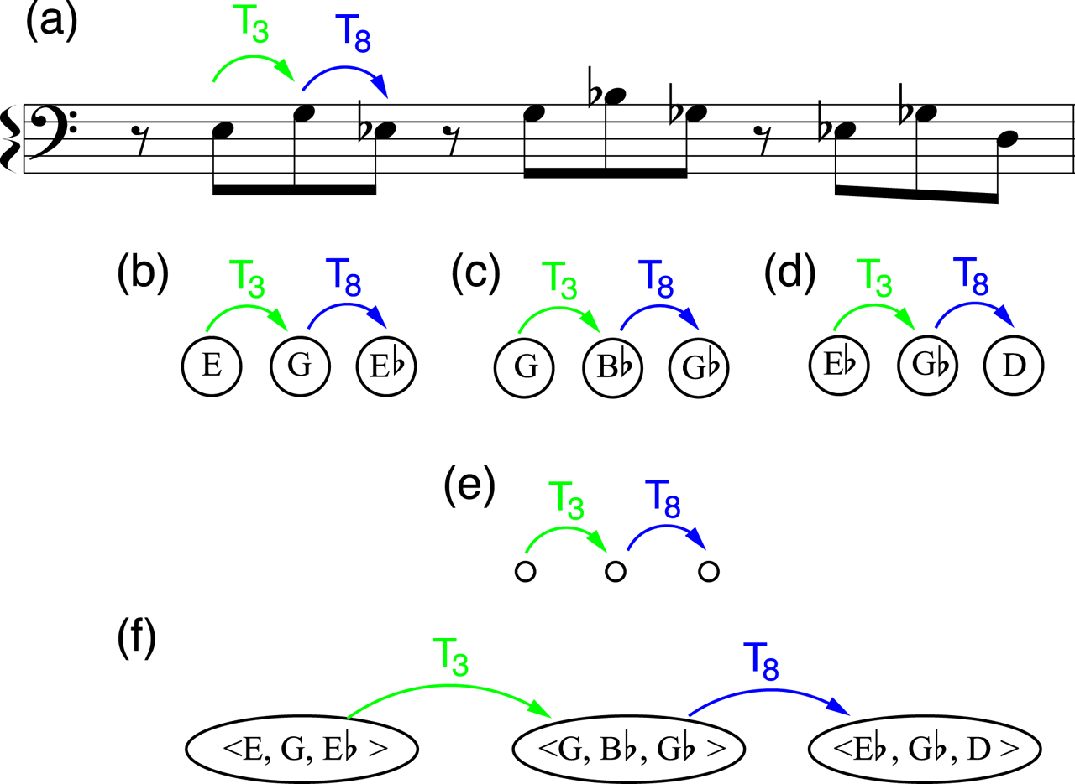
Example 1 . Networks and isography in excerpt from Schoenberg’s “Nacht,” Op. 21, No. 8.

Slide 4
transformational network
For a given network, the objects must be all of the same sort of percept, but the options may represent a variety of musical processes.
Every transformation must be a function;
every transformation must combine with every other;
the family of objects is closed under the transformations.
Other constraints on the arrow labels as well.

Slide 5
Transformation or merely relation?
Networks sometimes presented as concise representations of distances or relations among entities rather than as changes.
Fundamentally transformational theory treats music as intentional process
Directed arrows assert a temporal, or at least conceptual, order
Label focuses attention on action that alters one object into another
Lewin granted his arrows “phenomenological presence”
“Action” implies the existence of agent who chooses and effects changes and to whom the listener may attribute meaningful intent.
Transformational networks represent music as dynamic communication rather than as static design

Slide 6
Four aspects of transformational theory
isography as source of compositional unity and principle of large-scale progression;
interpretation of transformations as “structuring forces” that drive musical continuity and development;
two views of form
manifestation of the systematic properties of transformations
manifestation of objects as members of a structured space of possibilities.

Slide 7
Isography, Contextual Progression, and “Composing out”
Isography apparent in the networks of Examples 1(b), 1(c), and 1(d).
Each manifests the same graph, namely the labeled node-arrow system in Example 1(e), on the same small scale.

Slide 8
Isography, Contextual Progression, and “Composing out”
The transpositions that structure the family of pcs also define transpositionally equivalent pitch-class series, as in Example 1(f).
We can hear those distinctive transformations, established contextually by local continuity of the motive.
The recursion gives “Nacht” hierarchical depth.

Slide 9
“Berceuse II” from György Kurtág’s Kafka Fragmente for soprano and violin, Op. 24 (1985–87)
alternates the words “geschlafen” (slept) and “aufgewacht” (woke up); concludes with the outburst “elendes Leben!” (miserable life!)
Each “aufgewacht” set mimetically by rising fourths and fifths,
Each “geschlafen” features thirds, an arch contour, and a sedate rhythm (in a postmodernist allusion typical of Kurtág, its first two instances echo the Kopfmotiv of Schoenberg’s “Nacht”)

Slide 10
Example 2 Transformational interconnections of motives in Kurtág’s “Berceuse II” from Kafka Fragmente, Op. 24.
By interpreting the intervals as the result of transpositional actions, the listener can hear the passage as portraying an interplay between two states of consciousness.
pitch class transpositions applied to pitch classes (solid) or to members of two different types of pitch-class series (dashed)
Sleep motives change by the same succession of transformations that produce the waking motive: T6 then T5 (common pitch, Bb4)
T8 links the two statements of “aufgewacht” (the 2d statement presents T6 and T5 in retrograde)

Slide 11
Structuring fources w/o isography
Adams’ orchestral foxtrot The Chairman Dances (1985) builds up an ostinato by the staggered entrance and repetition of brief ideas, which shift abruptly to a series of chord progressions
The ostinato may be heardas a B11 chord
Yet the order of motives’ appearance, and the changes some of them undergo, encourage conceiving of them as the result of a dynamic expository process in which each new idea is motivated by or expands on the previous ones
This dynamic conception shows how the ostinato prepares the chord progressions

Slide 12
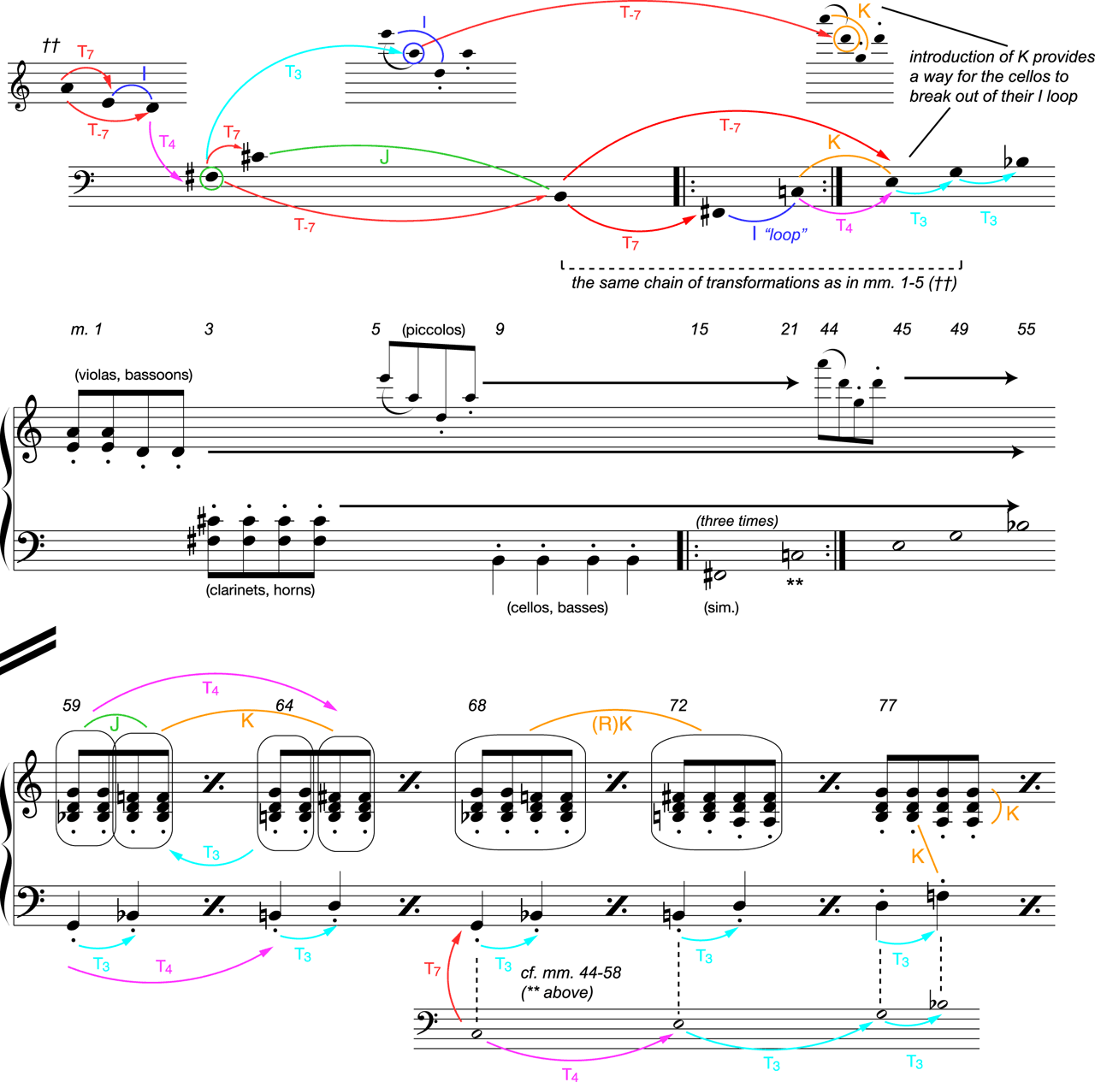
Example 3. Structuring forces in Adams’s The Chairman Dances, mm. 1-91.
Colored arrows indicate recurring transformations.

Slide 13
The first idea alternates a dyad {E4, A4} with D4, suggesting that we hear D as a transformation of {E4, A4}.
Our transformational systems takes as objects the family of 12 pcs and their transformations as the pc transpositions and inversions.
E is T7 of A; A is T7 of D (D is the inversion-around-A of E)

Slide 14
Piccolos clarify this inversional relation, moving from E6 to A5, then from D5 to A5
Before this the clarinets and horns reiterate {F#, C#} dyad, another T7 (or T4 of the D in m.1).
The T7 suggests that its inverse T–7 will manifest: the basses’ Bs, which are T–7 (F#).

Slide 15
The piccolos’ gestures help us to hear the clarinets, horns, and string pitch classes analogously: B is the inversion-around-F#, of C#, a labeled J.
Two inversionally structured networks, higher produced from lower by T3.
The B, as a fulfillment of expected processes, sounds closural.
Accordingly, the ostinato settles on a six-note chord.

Slide 16
In m. 15, the structuring force of T7 produces from the bass B an F# that alternates 3x with C.
This alternation emphasizes I’s stubborn quality: I is its own inverse, and shuttles between two notes. The looping <F#, C>s recall the looping <E, D>s, which also result from repeating , which lasts for 30mm.

Slide 17
At m. 44 the piccolos’ new gesture is generated from their previous by T–7. It suggests a new structural transformation, inversion-about-D, labeled K.
In the next m., K breaks the I-loop impasse in bass by changing C to E.
This is also aT–7 from the B that initiated the thumping idea, and it repeats the T4 that generate the first F#

Slide 18
The larger-scale organizing process
Starting from B, vc and cb change by T7, then I, then T4—the transformations that generated <A, E, D, F#> .
The low strings echo and synthesize other ideas.
The chain of transformations continue: E is T3. This large-scale repetition achieves some closure.

Slide 19
As another T3 pushes cbs to Bb, the texture changes at m. 59 to chord pairs with 4 distinct progressions.
The chain of transformations reappears, embellished. The bass in mm. 59–77, <G-Bb, B-D, D-F>, applies T7, to each of the pulsed bass notes in mm. 44–49 <C, E, G>, elaborating each resulting note with T3.

Slide 20
The chord progressions themselves manifest these structuring forces
The J transformation applied to G minor generates Bb major.
K applied to Bb major produces B minor, the T4 transformation of G minor, which alternates in m. 64 with G major.

Slide 21
The chord progressions themselves manifest these structuring forces
The <B minor, D major> progression (m. 72) is the retrograde-K of <G minor, Bb major>
The F and A of the nontriadic chord (m. 77) are K-generated from G major.
The structuring force of K is signified by its inversional center, D.

Slide 22
Form as a Manifestation of Systematic Properties of Transformations
Superficially “Les champs,” from Adès’s Lieux retrouvés, Op. 26 (2009) seems elemental.
The cello sequences a 4-note motive.
Every fourth repetition, it omits the last note, usually skipping an 8th-note beat, then restarts the sequence, creating a 4-bar phrase.
Within each phrase the sequence proceeds by ascending P4 or descending P5.
Arrows aren’t enough.
Why are some transformations used and not others?
Why do certain events have special, crucial roles in a piece?

Slide 23
All phrases of Adès’s “Les champs” but the last, which repeats the 5th 8va

Slide 24
But m. 5, {E, F, G, A} is an inversion of m. 1, {E, F#, G#, A}, the inversion that holds fixed {E, A}—interval class 5.
We may consider the family objects in the transformation system the 24 members of the TnI set class (0135), which includes sol-la-ti-do and ti-do-re-mi in all 12 major scales.

Slide 25
But m. 5, {E, F, G, A} is an inversion of m. 1, {E, F#, G#, A}, the inversion that holds fixed {E, A}—interval class 5.
We may consider the family objects in the transformation system the 24 members of the TnI set class (0135), which includes sol-la-ti-do and ti-do-re-mi in all 12 major scales.

Slide 26
Mms 2 and 6 are T5 and manifest the transformation changing m. 1 to m. 5. transformation P: hold the 8th notes (D and A).
P is a “contextual” inversion whose center depends on which version of the motive it is transforming.
P changes m. 3 to m. 7 (preserving G and D) and m. 4 to m. 8 (their 2nd 8th notes omitted).
These transformations symbolized by an arrow connecting nodes that represent the contents of the motives.

Slide 27
M. 1 to m. 5. P: [A, B, C#, D] = [9E12] —> [A, Bb, C, D] = [9T02]
M. 3 to m. 7 P: [D E, F#, G] = [2467]—> [D, Eb, F, G]= [2357]
M. 4 to m. 8 P: [G, A,C] = [790] —> [G, Ab, C] = [780]

Slide 28
M. 17 corroborates this conception, as the inversion of m. 1 that preserves the 2 long notes, {F#, G#}—the two members of the motive that do not belong to ic 5.
Example 4(a) highlights in green common tones in m. 1 and m. 17: transformation Q; it also changes the pcs of m. 2 to those of m. 18 and m. 3 to m. 19.

Slide 29
Supports a binary hearing of the movement: P and T5 mm. 1–5, T5 mm. 8–10; m. 13 return on m. 1 and T5 transform; mm. 15–16 “wrong notes” in vc; m. 17 return of motive with Q transform and T5.

Slide 30
Ex. 4. Transformational account of Adès’s “Les champs” from Lieux retrouvés, Op. 26

Slide 31
Group theoretic properties: P and Q commute with T5.
All of mm. 5–8 can be understood as a node in a higher level network.
This supports a grouping hierarchy that is articulated by rhythm and contour.

Slide 32
Form as Manifestation of a Transformational Space
Bright Sheng’s The Stream Flows, I
The beginning of each segment is marked by a constellation of intervals, contour, and rhythm that evoke a popular folk melody from the Yunnan province of China.
The allusion focuses attention on (anhemitonic) pentatonic collections.
A single pc name denotes the middle note in the do-re-mi succession.
A middle section, mm. 26–51, intensifies the texture. The shortest segments can be heard as either 1 pentatonic collection or 2 pentatonic collections in different registers.
Red Vs mark a diatonic ascent (from D5 to E6) of pitch-climaxes in successive segments.

Slide 33
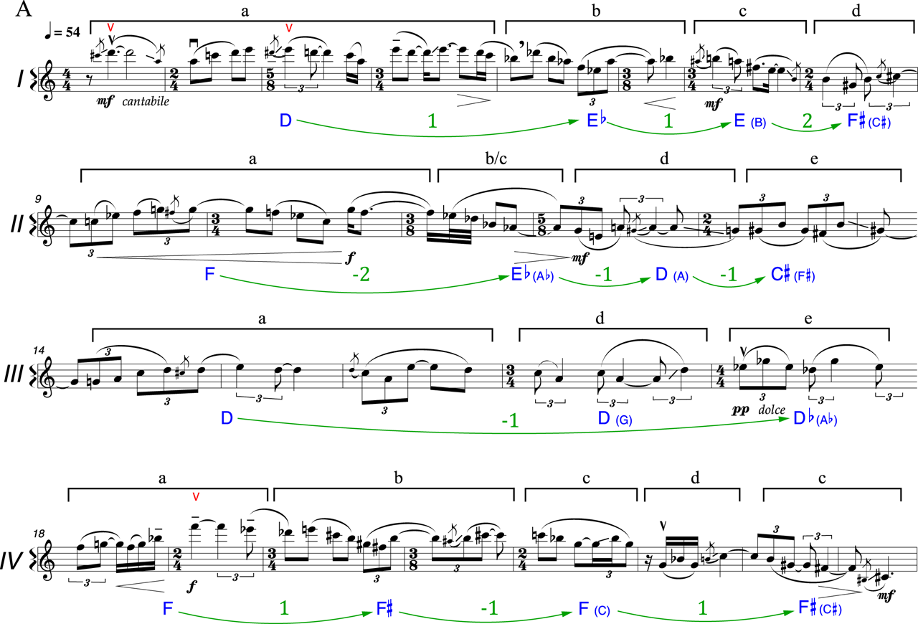
Ex. 5. Pentatonic collections and transformations in Bright Sheng’s The Stream Flows, I

Slide 34
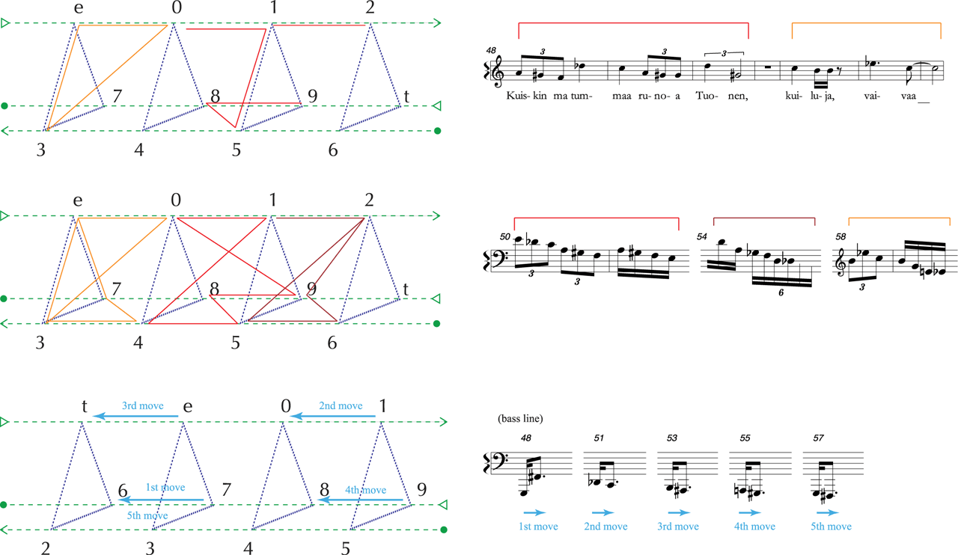
Ex. 6. Transformational space for concluding section, Saariaho’s “Sydän” from Leinolaulut

